Slide 1

Automating INFORMATION SECURITY WITH PYTHON
BY MZW

Slide 2
DAY 1
Introduction to Python
Installing Python
Basic Python concepts
Functions and modules
Lists and dictionaries

Slide 3

INTRODUCTION TO PYTHON
Python is a scripting/interpreted language.
Difference between interpreted (Python, JavaScript, PHP) and compiled language (C, C++, Go).
automate tasks
manipulate data
control other software applications
not compiled into machine code before execution ;
executed line by line by an interpreter
EOL Python2 , but Python3 do provide backward compatibilities with Python2.

Slide 4
Installing Python and Setting up the development env.
Go to https://www.python.org/downloads/ to install Python3 suitable for your Operating System.
Go to https://bootstrap.pypa.io/get-pip.py to install PIP (Pip Installs Packages)
easily install, manage and uninstall Python packages. (pip install <package>)
Go to https://www.jetbrains.com/pycharm/download/?section=windows to install development environment for Python.
Integrated Development Environment (IDE) for Python
to assist developer in writing, testing, and debugging code more efficiently.

Slide 5
BASIC PYTHON CONCEPTS
Variables and Data Types
What is a variable?
Data types
Numeric : int, float
String : str
Boolean : bool
List : []
Tuple : ()
Dictionary : {:}
Set : {}
NoneType : None
Examples

Slide 6
What is a variable
Containers that store data.
Named for accessing content.
Hold different types of data.
Manipulate and work with data.
Created with a name and value assignment.
Access and modify values using the name.
Dynamically-typed (type inferred).
Follow naming rules (letters/underscore).
Essential for effective programming.

Slide 7
NUMERIC
x = 5
y = 3.14

Slide 8
STRINGS
name = "John"
message = 'Hello, World!'

Slide 9
BOOLEAN
is_valid = True
has_error = False

Slide 10
LISTS
numbers = [1, 2, 3, 4, 5]
fruits = ['apple', 'banana', 'orange']

Slide 11

Tuple
coordinates = (10, 20)

Slide 12
Dictionary
Pair of Key and Value
person = {'name': 'Alice', 'age': 30}

Slide 13

SET
Set of unique values
unique_numbers = {1, 2, 3}

Slide 14
NoneTYPE
result = None

Slide 15
INTRODUCTION TO CONTROL FLOW
Conditional statements (if , elif, else)
Loops (while, for)
Break and Continue

Slide 16
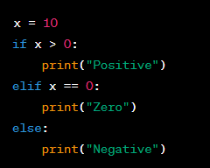
CONDITIONAL STATEMENT
If, elif, else

Slide 17
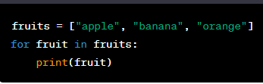
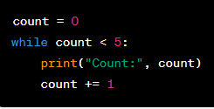
LOOPS
while
execute as long as the condition is true
for
iterate over a sequence

Slide 18
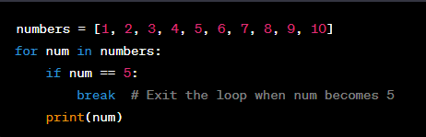
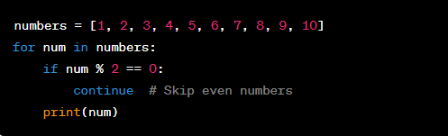
Break / Continue
break
used to exit out of a loop prematurely when a certain condition is met
continue
used to skip the rest of loop’s body for the current iteration and proceed to the next iteration

Slide 19
Working with numbers and strings
Simple addition of numbers.
Simple addition of strings.
What happen if numbers and strings are being concatenated together?

Slide 20
BASIC INPUT AND OUTPUT PROCESSING
Exercise : Write a simple calculator by taking input from the user.

Slide 21
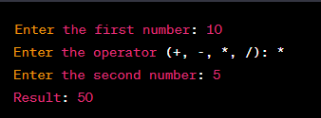
SIMPLE Calculator

Slide 22
BASIC INPUT AND OUTPUT PROCESSING
Exercise : Write a string, calculate string length, accessing characters, slicing strings.

Slide 23
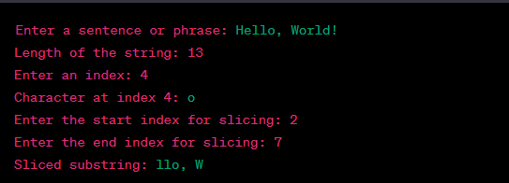
BASIC INPUT AND OUTPUT PROCESSING

Slide 24

FUNCTIONS AND MODULES

Slide 25

FUNCTIONS
Functions are blocks of code that perform specific tasks.
They are defined using the def keyword followed by the function name and code block.
Functions are reusable and help break down complex tasks into smaller, manageable pieces.
They can have parameters (input) and return a value (output).

Slide 26
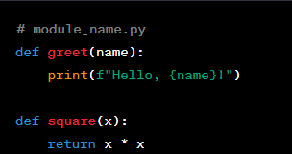
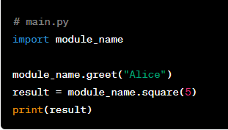
MODULES
Modules are Python files containing reusable code, including functions, classes, and variables.
They promote code reusability and maintainability by organizing related code into separate files.
To use a module, you import it using the import statement and access its content using the module name.

Slide 27
LIST AND DICTIONARIES
Recap
numbers = [1, 2, 3, 4, 5]
person = {'name': 'Alice', 'age': 30}

Slide 28
LISTS AND DICTIONARIES OPERATIONS
Exercise :
Create a list of fruits
Add new fruit to the list
Remove a fruit from the list
Print the length of the list
Print the list in reverse order
Exercise :
Create a dictionary to store the names and ages of three people.
Add a new person to the dictionary.
Remove a person from the dictionary.
Print the keys (names) in the dictionary.
Print the values (ages) in the dictionary.

Slide 29
LISTS OPERATIONS
append
remove
len(list)
list[::-1]

Slide 30
DICTIONARIES OPERATIONS
dict[“key”] = value
del dict[“key”]
list(dict.keys())
list(people.values())

Slide 31
EXTRAS
File Handling
Advanced Control Flow

Slide 32
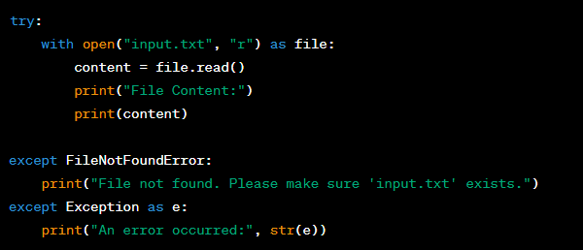
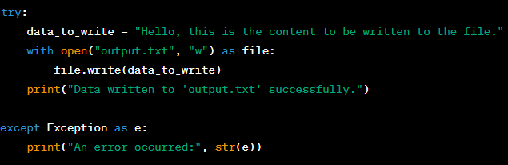
FILE HANDLING IN PYTHON
Read a file
Write to a file

Slide 33
File Handling Exercise
Create a simple file handling python script that involves reading data from a file, performing a task, and writing the result back to another file.
Input File:
Create a text file named input.txt.
Write some numbers separated by spaces in the file, e.g., "10 5 3 7 15".
Task:
Read the numbers from input.txt.
Calculate the sum of these numbers.
Output File:
Create a new text file named output.txt.
Write the sum calculated in step 2 to output.txt.

Slide 34

SOLUTION
# Read input numbers from input.txt
with open("input.txt", "r") as input_file:
numbers_str = input_file.read().split()
# Convert the input strings to integers and calculate the sum
sum_numbers = 0
for num_str in numbers_str:
sum_numbers += int(num_str)
# Write the sum to output.txt
with open("output.txt", "w") as output_file:
output_file.write(str(sum_numbers))

Slide 35
Advanced control flow
Nested loops and conditional statements –> Quick Recap -> nested version
Exception handling for error management

Slide 36
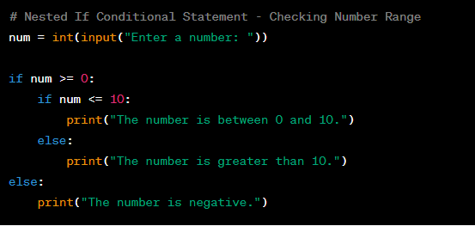
NESTED LOOPs EXAMPLE

Slide 37
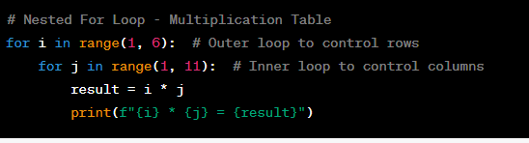
CONDITIONAL STATEMENTS EXAMPLE (NESTED)

Slide 38
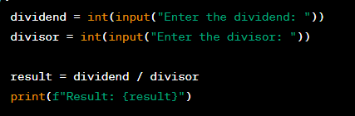
EXCEPTION HANDLING FOR ERROR MANAGEMENT
try and except are often used.
another exercise ☺
Input ‘10’ and ‘2’, what do you get?
Input ‘20’ and ‘0’, what do you get?
Input ‘a’ and ‘5’, what do you get?

Slide 39
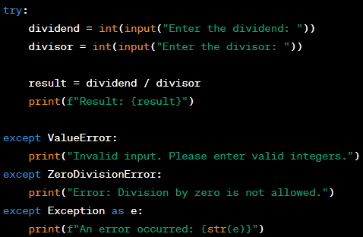
EXCEPTION HANDLING AND ERROR MANAGEMENT - SOLUTION

Slide 40
EXCEPTION HANDLING FOR ERROR MANAGEMENT - CONCLUSION
Manage error gracefully
Prevent from crashing the program
Provide meaningful error messages to the user

Slide 41

END OF PYTHON BASICS

Slide 42

INFORMATION SECURITY + PYTHON

Slide 43
BENEFITS
Automation: Python simplifies automating security tasks, saving time and effort.
Custom Tools: Python allows creating tailored security tools for specific needs.
Rapid Prototyping: Python's ease of use aids quick testing and iteration.
Integration: Python works well with security APIs and libraries.
Cross-Platform Support: Python runs on various systems.
Data Analysis: Python aids analyzing and visualizing security data.
Machine Learning: Python facilitates ML for threat detection.
Community Support: Python has a large and helpful community.
Security Education: Python is beginner-friendly for security learning.

Slide 44
DAY 2
Python Basic Networking Tools
Advanced Networking Tool
Network Sniffer

Slide 45
Exercise
Create basic networking tools
TCP Client
UDP Client
Create TCP communication channel
TCP Client + TCP Server

Slide 46
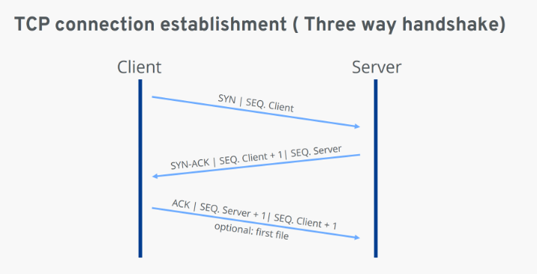
BASIC NETWORKING TOOLS
Transmission Control Protocol (TCP)

Slide 47
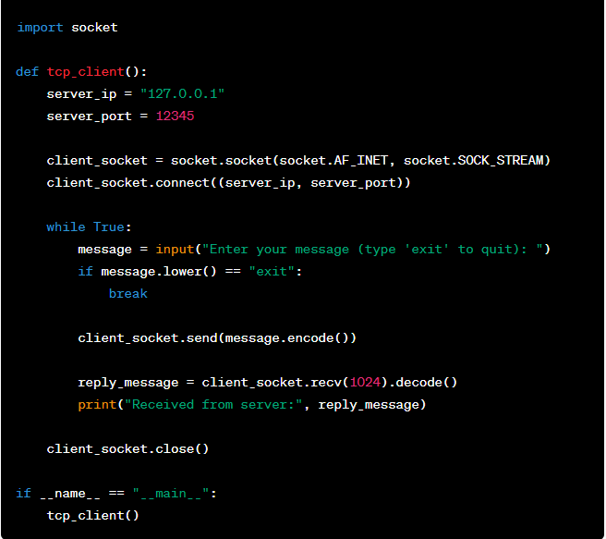
TCP CLIENT

Slide 48
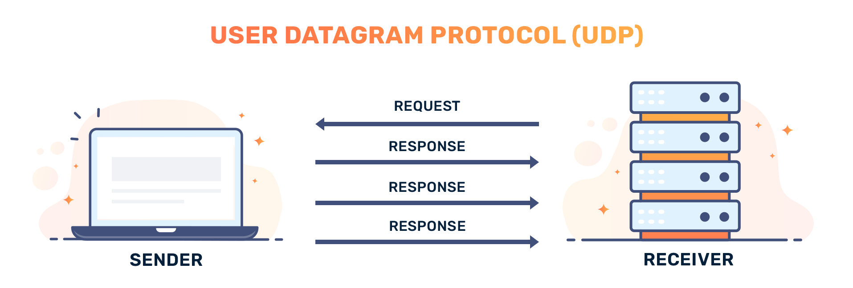
BASIC NETWORKING TOOLS
User Datagram Protocol (UDP)

Slide 49
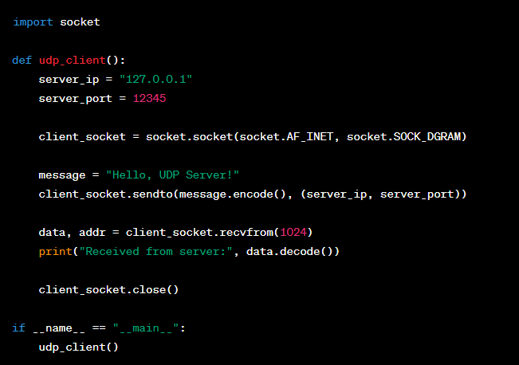
UDP CLIENT

Slide 50
ADVANCED NETWORKING TOOL - NETCAT

Slide 51
WHAT EXACTLY IS NETCAT?
a versatile networking tool used for ;
network communication : easy communication between devices
port scanning : checks for open ports on target systems, aiding in security assessments
file transfer : transfers files between computers
port forwarding : redirects traffic
banner grabbing : retrieve service information from open ports
remote shell access : acts as a simple backdoor for remote command execution
protocols testing : diagnose and test protocols like HTTP, SMTP, etc
proxying : data flow to two systems, acting as an intermediary
port listening : listen for incoming connection, ie : for setting up services
network debugging : assists in debugging network-related issues and testing

Slide 52
OUR VERSION OF NETCAT
We wanted to create our own version of netcat that at least can ;
run OS commands
get banner
transfer file (getting the file from server to client)

Slide 53
STEPS
Import necessary libraries
import sys
import socket
import subprocess
Create functions
run OS command
use subprocess library to execute OS command
return the result of execution
function to handle server side
exit
banner
transfer
function to handle client side
exit
banner
transfer
main function

Slide 54
NETWORK SNIFFER
What is a network sniffer?
Monitoring Tool: A network sniffer is a software or hardware tool used for network monitoring and analysis.
Packet Inspection: It captures and analyzes data packets as they traverse a network.
Passive Observation: A sniffer operates passively, listening to network traffic without interfering with it.
Data Collection: It extracts information from packets, such as source and destination addresses, content, and protocols.
Diagnostic Tool: Network administrators use sniffers to troubleshoot network issues, identify bottlenecks, and analyze performance.
Security Analysis: Sniffers can help in detecting and investigating network intrusions or suspicious activities.
Privacy and Legal Concerns: Unauthorized use of network sniffers can violate privacy rights and legal regulations, emphasizing the importance of ethical and lawful utilization.

Slide 55

NETWORK SNIFFER (DEMO)

Slide 56
DAY 3
Introduction to security vulnerabilities in systems
Attacking a vulnerable application using Python

Slide 57

WHAT ARE SECURITY VULNERABILITIES?
Weaknesses in computer systems that can be exploited by attackers to gain unauthorized access, steal information or cause harm.

Slide 58
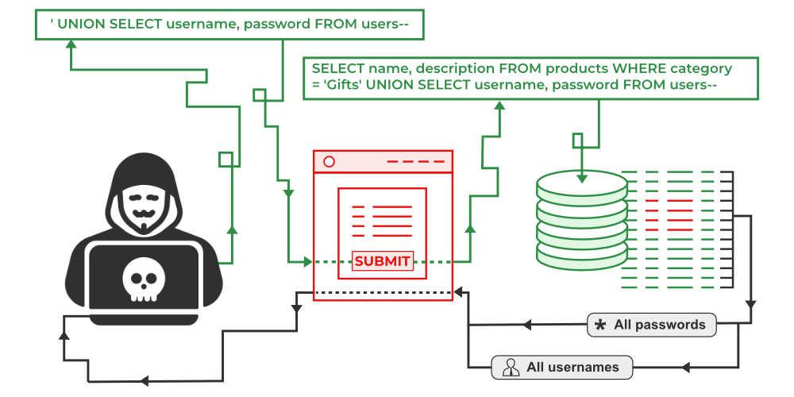
Examples – SQL Injection

Slide 59

SQL INJECTION
DEMO

Slide 60
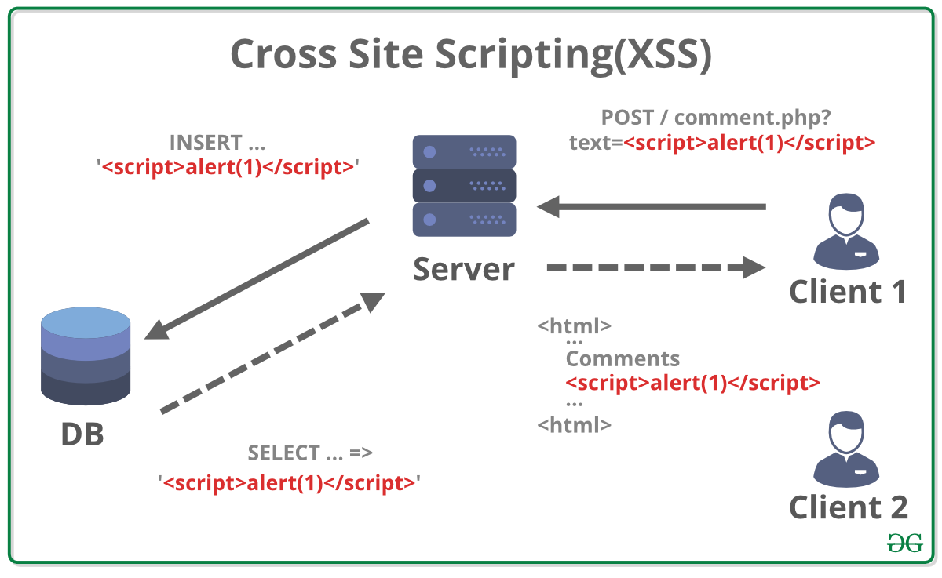
EXAMPLES – Cross site scripting (XSS)

Slide 61

CROSS SITE SCRIPTING
DEMO

Slide 62
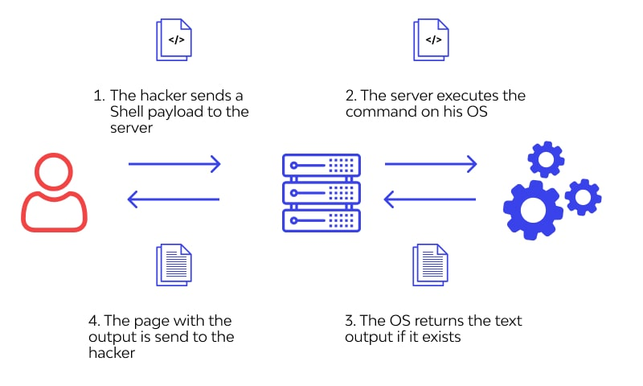
EXAMPLES – OS COMMAND INJECTION

Slide 63

OS COMMAND INJECTION
DEMO

Slide 64

Attacking a vulnerable application using Python

Slide 65
TEST CASE 1 : REMOTEMOUSE APPLICATION
Description : RemoteMouse is a program that allows user to control their computer using a mobile device as a mouse and keyboard.
Problem : No authentication is required for the application.
Implication : Any attacker will be able to gain control to the affected system.
Proof of concept : DEMO

Slide 66

TEST CASE 2 : FTP/HTTP File Server 2.1.2
Vulnerability description :
the application fails to adequately validate user-supplied input.
leads to a remote command execution attack
DEMO

Slide 67
CRAFTING AN EXPLOIT
Create a connection to the server using socket library
request for our command as an input
add a HTTP request – GET request and inject our command
format the request to simulate a proper HTTP request
send the payload, encode it to bytes
close the socket
encapsulate with try except for exit condition (KeyboardInterrupt)
keep sending injected command (windows command) until exit (while True)

Slide 68

END

